Slide 1
SMART GLOVES FOR DUMB AND VISUALLY IMPAIRED PEOPLE
Project Carried Out By:
GILBERT DANIEL (42150014) GOKULA KRISHNAN (42150015)
JITEN PRABURAM (42090015) MOHAMMED AFZEL (42090017)
Under the Supervision of:
Dr.B.Kanimozhi(Professor) Mr.K.Balachandar (Associate Professor)
Department of Mechanical Engineering
BATCH No:
45
DEPARTMENT OF MECHANICAL ENGINEERING SATHYABAMA INSTITUTE OF SCIENCE AND TECHNOLOGY
(DEEMED TO BE UNIVERSITY)

Slide 2
ABSTRACT
The Smart Glove project aims to enhance communication for individuals who are deaf or hard of hearing by translating sign language gestures into real-time text or speech. This innovative wearable technology uses sensors embedded in the glove to detect hand movements and gestures, which are then processed and converted into readable or audible outputs. The system provides an efficient, user-friendly interface that bridges the communication gap between the deaf and hearing communities. By offering a practical and accessible solution, the Smart Glove empowers users to communicate independently without the need for interpreters or specialized knowledge. The project’s core objectives are to improve social inclusion, support educational and professional opportunities, and promote greater autonomy for deaf individuals. Ultimately, the Smart Glove seeks to foster a more inclusive society where effective communication is accessible to all, regardless of hearing ability and visual impairment.

Slide 3
OBJECTIVE
The objective of the Smart Glove project for individuals who are deaf or hard of hearing is to enable seamless communication by converting sign language gestures into text or speech. The key goals include:
Real-Time Translation: Accurately translating sign language into text or speech for effective communication.
User-Friendly Design: Creating a comfortable and easy-to-use device for all users.
Social Inclusion: Enhancing access to communication in social, educational, and professional settings.
Efficiency: Ensuring fast and accurate translation to improve communication speed.
Affordability: Making the device accessible to a wide range of users.
Empowering Independence: Allowing deaf individuals to communicate without relying on interpreters.
Device Integration: Ensuring compatibility with smartphones and other digital platforms.
The goal is to improve the quality of life for deaf individuals by enabling independent, effective communication and promoting social inclusion.

Slide 4
METHODOLOGY
Developing smart gloves for deaf, mute, and blind individuals requires a structured methodology to ensure functionality, usability, and efficiency. Below is a standard methodology that can be followed for such a project:
Problem Identification & Research
Understand the communication challenges faced by deaf, mute, and blind individuals.
Study existing assistive technologies and their limitations.
Conduct user research by interacting with potential users and experts.
Requirement Analysis
Define the key features the smart gloves should have (e.g., sign language recognition, speech conversion, haptic feedback).
Identify hardware and software requirements.

Slide 5
METHODOLOGY
Design & Development
A. Hardware Design
Select appropriate sensors (e.g., flex sensors, accelerometers, gyroscopes) for gesture recognition.
Choose a microcontroller (e.g., Arduino, Raspberry Pi, ESP32).
Include haptic feedback mechanisms (e.g., vibration motors) for blind users.
Integrate a speaker or text-to-speech module for mute users.
B. Software Development
Develop an algorithm for gesture recognition using machine learning (if required).
Implement sign-to-text and text-to-speech conversion.
Create a user-friendly interface (mobile app or embedded system).

Slide 6
METHODOLOGY
Prototype Development
Assemble the hardware components on a glove.
Program the microcontroller to process sensor data and communicate with other components.
Test initial functionality.
Testing & Validation
Conduct performance testing on gesture recognition accuracy.
Test response time of text-to-speech conversion.
Collect user feedback from deaf, mute, and blind individuals.
Refine the design based on real-world testing.

Slide 7
METHODOLOGY
Optimization & Finalization
Improve power efficiency, processing speed, and user experience.
Make the gloves lightweight and comfortable.
Ensure compatibility with multiple sign languages (if applicable).
Deployment & Documentation
Develop user manuals for ease of use.
Conduct field trials and finalize the product.
Prepare a report detailing the methodology, results, and future scope.

Slide 8
MATERIALS & PROCESSES
The Arduino Uno R3 SMD is a microcontroller board based on the surface-mount version of the ATmega328P chip. It offers the same functionality as the standard Uno R3 but uses an SMD chip, making it more compact and durable. The board has 14 digital I/O pins, 6 analog inputs, and runs at 16 MHz. It connects to a computer via USB and is programmed using the Arduino IDE. Ideal for beginners and hobbyists, it's perfect for learning electronics, building prototypes, and working on DIY or IoT projects.
The ADXL335 is a small, thin, low-power, 3-axis analog accelerometer that measures acceleration in the X, Y, and Z axes. It operates on 3.3V to 5V and outputs analog voltage signals proportional to acceleration. With a measurement range of ±3g, it’s ideal for detecting tilt, motion, and vibration. The ADXL335 is often used in robotics, smartphones, gaming controllers, and wearable devices. Its simple analog output makes it easy to interface with microcontrollers like Arduino for motion-sensing projects.

Slide 9
MATERIALS & PROCESSES
A high-fidelity (hi-fi) speaker is designed to reproduce sound with exceptional clarity and accuracy, staying true to the original audio recording. Hi-fi speakers are commonly used in home audio systems, studios, and high-end entertainment setups. Used to send the voice variation of the sign showed.
The LCD display in smart gloves for the deaf and dumb converts hand gestures into readable text. It provides real-time visual feedback, helping bridge communication gaps. Typically compact and low-power, these displays clearly show interpreted messages, making the gloves effective for silent communication in various environments.

Slide 10
MATERIALS & PROCESSES
DF PLAYER a popular series of mini mp3 player used to build and connect the speaker that gives the voice for the given hand signs. It uses a preprogrammed and stored library that has the voice over the signs which will be conveyed out through the speaker when the hand signs are shown.
MB102 Bread Board used to build the electronic circuit for the project using various components of the project and using jump wires.
Jumper wires wires that have connector pins at each end, allowing them to be used to connect two points to each other without soldering.
STB Adapter used to connect a power supply to various devices in almost any setting.

Slide 11
LITERATURE SURVEY
YEAR | AUTHOR & JOURNAL NAME | INFERENCE
2019 | Wei-Chieh Chuang, Wen-Jyi Hwang, Tsung-Ming Tai, De-Rong Huang and Yun-Jie Jhang, Continuous Finger Gesture Recognition Based on Flex Sensors, | Usage of Flex Sensors to recognise continuous finger movements according to sign language and using machine learning to generate the speech and display.
2020 | Sonal Narsale and Pooja S Bhore, International Journal of Progressive Research in Science and Engineering | Architectural Design, Unified modelling Language(UML),and Binary format
2020 | Anisha M R, Ashwin S Nair, Anu Shreya, Chinnannagari Tharun, Design an implementation of smart glvoes for the Special Privileged | Gesture to Text recoginition, Obstacle Detection,Heart rate sensing
2021 | Varikuti Yaswanth Reddy, Pithani Tarakeswari, Govinda Sai Mohan Silantharajula SMART GLOVE FOR DEAF AND DUMB PEOPLE | Using of External Devices as Speakers and Display for better communication
2022 | Mr. Punit Vora, MR. Bhushan Parab,MR.Rohit Bandgar,Multi-Purpose Smart Glove for Differently Abled Community People | Usage of Bluetooth, Health monitoring system and sign language translating
2024 | Shravani Jadhav, Siddhi Mhatre, Riddhi Patil, Prachi Sorte, SMART GLOVES FOR DEAF AND DUMB PEOPLE 2024 | Usage of ACCELEROMETER

Slide 12
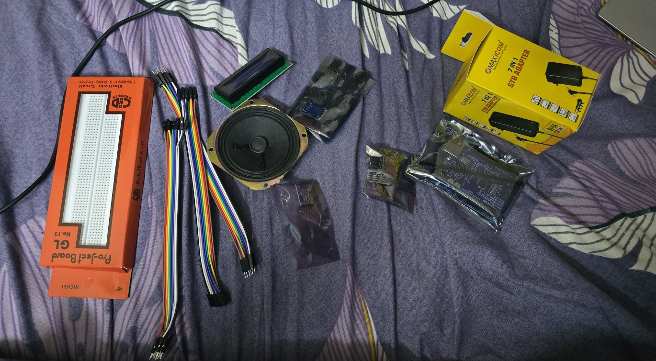
WORK DONE
Research work has been carried out .
Requirement Analysis.
Components gathered.

Slide 13
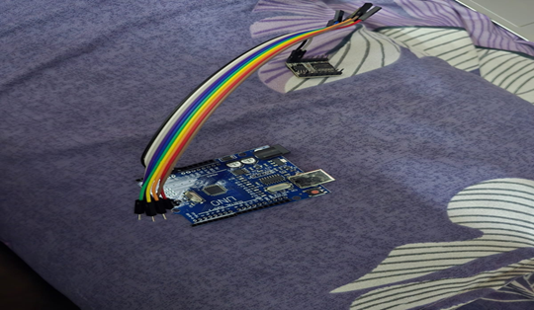
WORK DONE
Connection work started.

Slide 14
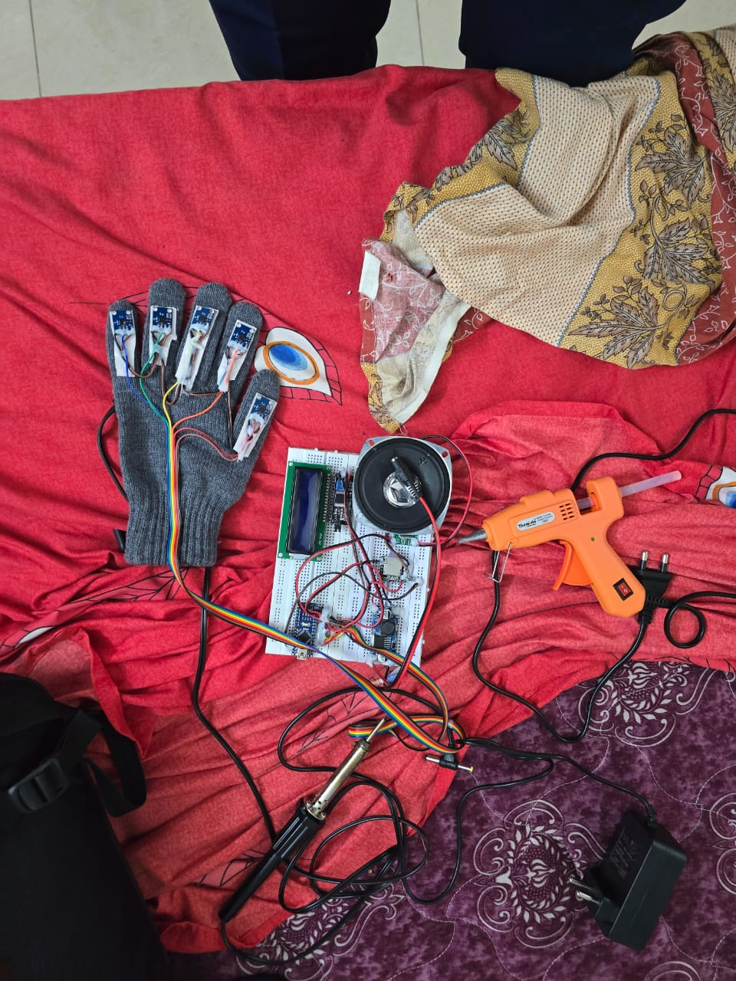
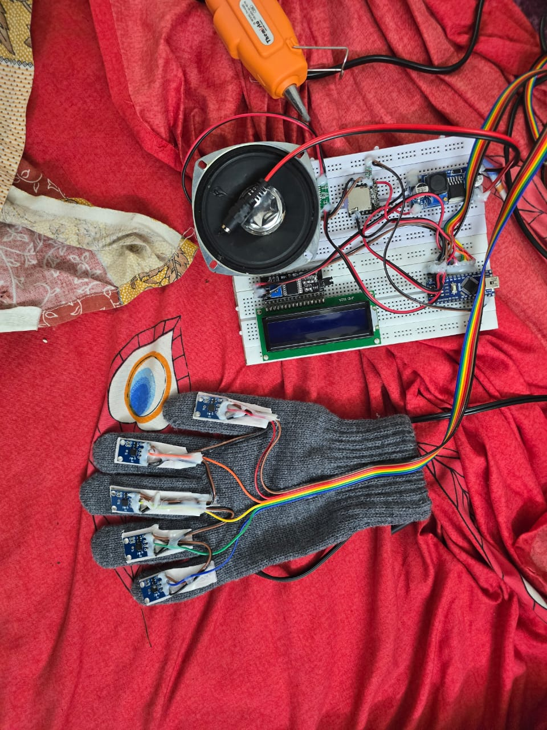
WORK DONE
Project is nearly complete and Reports work has been started .

Slide 15
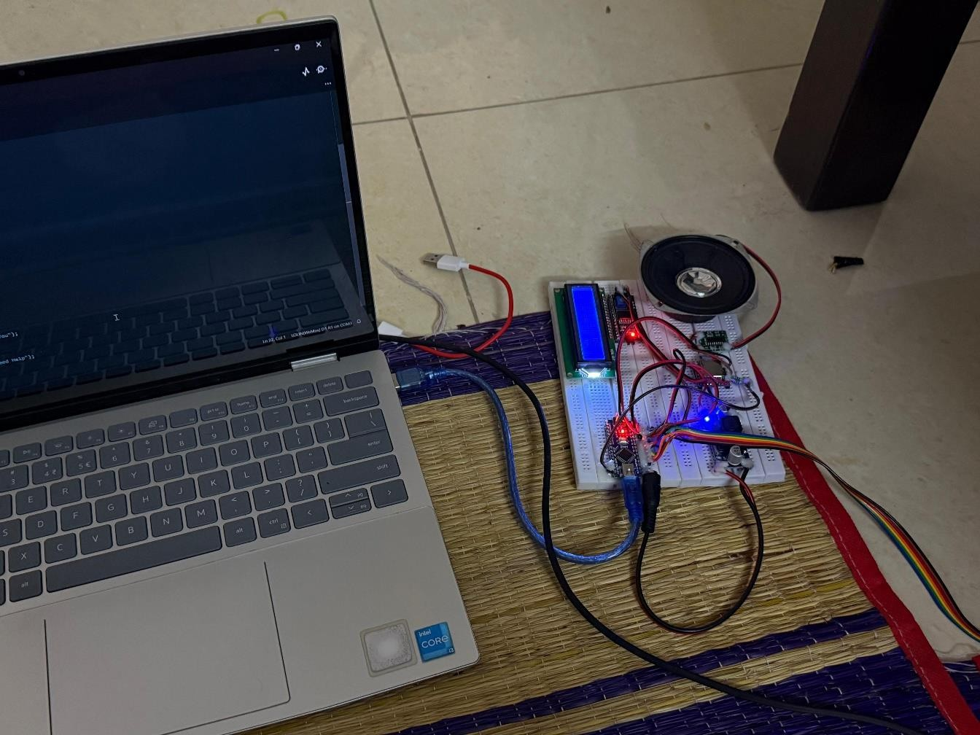
WORK DONE
Connection finished programming started.

Slide 16
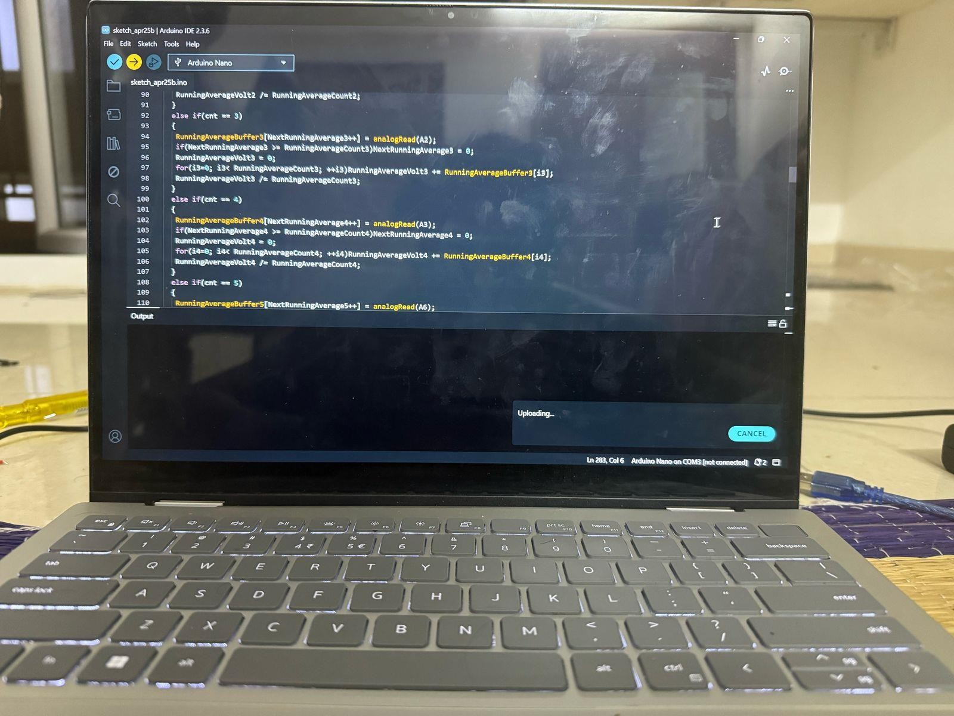
WORK DONE
Coding Process Undergoing

Slide 17
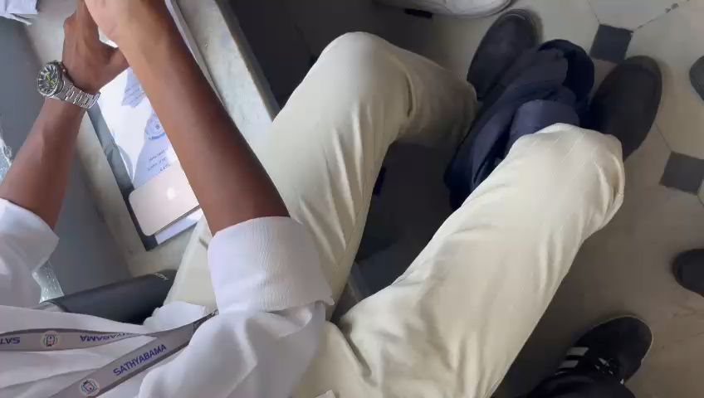
WORKING DONE
Working video.

Slide 18
FUTURE SCOPE OF THE PROJECT
To progress towards the future scope of the Smart Glove project, several key areas need focus:
Enhancing Gesture Recognition: Invest in research to develop advanced machine learning algorithms capable of recognizing a wider range of sign language gestures. Collaborating with AI experts to integrate deep learning models will improve the accuracy and scalability of gesture translation, allowing for more precise communication.
Multilingual Sign Language Support: Expand the glove’s capabilities to support multiple sign languages. Developing a comprehensive database that includes different regional sign languages (e.g., American Sign Language, British Sign Language, Indian Sign Language) will foster global inclusivity. Collaboration with sign language experts and communities is essential.

Slide 19
FUTURE SCOPE OF THE PROJECT
Virtual Assistant Integration: Integrate the Smart Glove with popular virtual assistants like Alexa, Siri, and Google Assistant. This will allow users to interact with smart devices using sign language, enhancing accessibility and usability.
Wearable Integration: Work on miniaturizing the glove and exploring partnerships with wearable tech companies to integrate it with smart glasses, watches, or other wearables for a more compact and seamless communication tool.
Real-time Communication: Focus on improving Bluetooth/Wi-Fi capabilities for real-time, low-latency communication, enabling live conversations between sign language users and non-users.
Design Refinement: Continuously iterate on the glove’s design for improved comfort, durability, and ease of use, ensuring it is suitable for long-term wear.
These steps will ensure the Smart Glove evolves into a more inclusive, effective communication tool for the future.

Slide 20
REFRENCES
Liu, Y., Yang, J., & Zhu, J. (2024). Simulation-driven design of smart gloves for gesture recognition. Scientific Reports, 14(1).
Khan, M. A., & Nadeem, M. (2022). Smart glove for sign language translation. International Journal of Advanced Technology and Engineering Exploration.
Wang, Y., & Zhang, L. (2022). A wearable smart glove for sign language classification. Sensors, 22(15), 5401
Bansode, A. R., & Kokare, S. (2020). Smart gloves for mute people using American Sign Language. International Journal of Research in Engineering, Science and Management, 3(5), 234–237.

Slide 21
REFERENCES
Reddy, V. Y., Tarakeswari, P., & Silantharajula, G. S. M. (2021). Smart Glove for Deaf and Dumb People. International Journal of Creative Research Thoughts (IJCRT), 9(5), 3672–3676.
Mr. Punit Vora, MR. Bhushan Parab,MR.Rohit Bandgar,Multi-Purpose Smart Glove for Differently Abled Community People,2022.
Shravani Jadhav, Siddhi Mhatre, Riddhi Patil, Prachi Sorte,SMART GLOVES FOR DEAF AND DUMB PEOPLE ,2024.

Slide 22
T H A N K Y O U

